Slide 1
Linear Regression

Slide 2
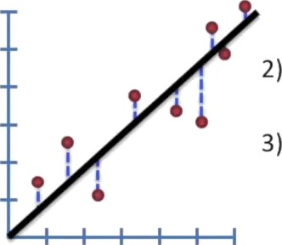
The Main Ideas!
1) Use lea5t-square5 to fit a a line to the data.
Calculate R²
Calculate a p-value for R²

Slide 3
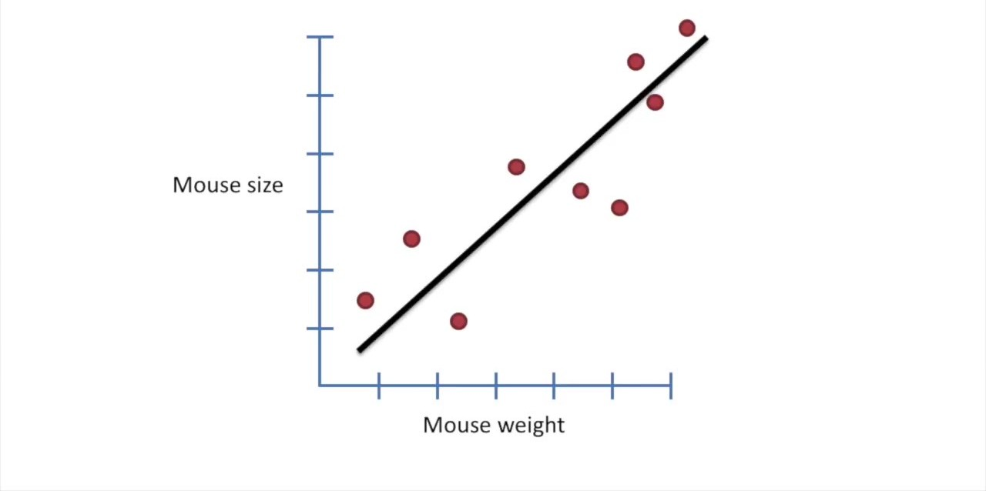

Slide 4
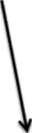

First, draw a line through the data...
Mou5e size
Mou5e weight

Slide 5
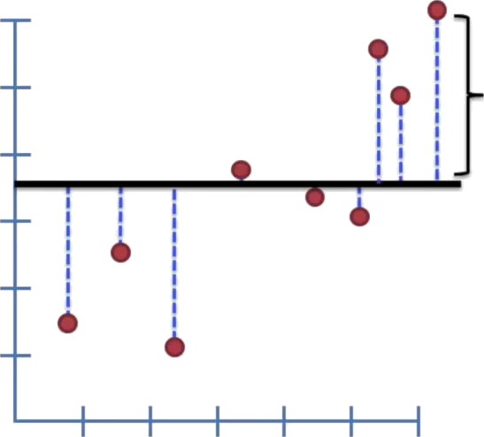
Second, measure the distance from the line to the data, square each distance, and then add them up.
Mou5e size
Terminology alert! The di5tance from a line to a data point is called a “residual”.
Mou5e weight

Slide 6
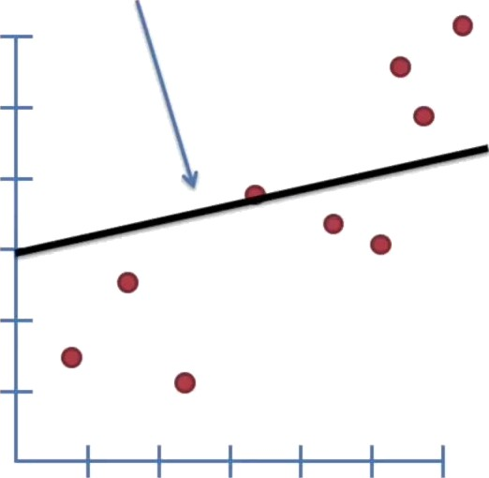
Third, rotate the line a little bit...
Mouse size
Mou5e weight

Slide 7
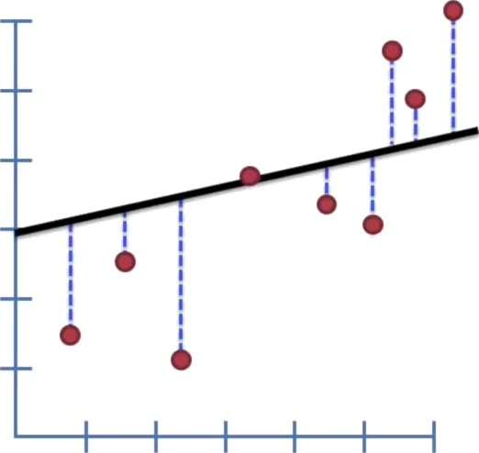
With the new line, measure the residuals, square them, and then Sum up the squares.
Mouse size
Mou5e weight

Slide 8
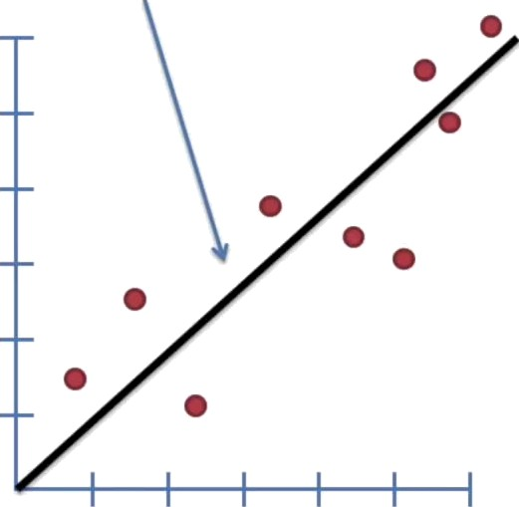
Rotate the line a little bit more...
Mou5e size
Mou5e weight

Slide 9
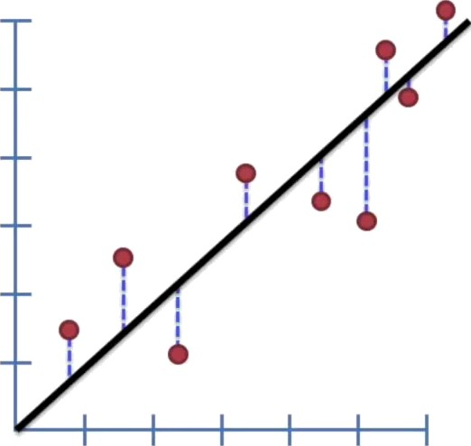
Sum up the squared
re5iduals...
Mou5e size
Mouse weight

Slide 10
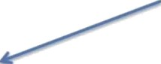
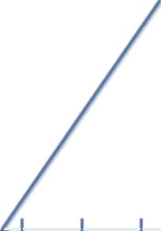
After a bunch of rotations, you can plot the sum of squared residuals and corre5ponding rotation.
Sum of --
squared
re5iduals
e
Different rotations:

Slide 11
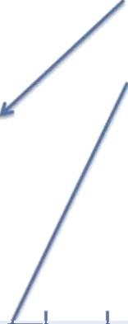
After a bunch of rotations, you can plot the sum of squared residuals and corre5ponding rotation.
Sum of | -- | e
squared residuals | —-
e
Different rotations:

Slide 12
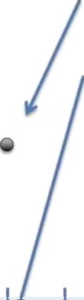
Sum of --
squared
residuals --
After a bunch of rotations, you can plot the sum of squared residuals and corre5ponding rotation.
e
e
Different rotations:

Slide 13
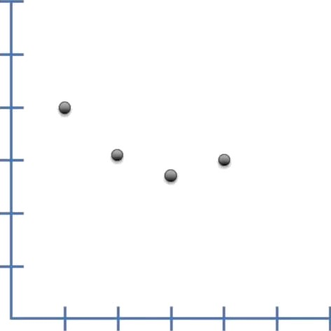
Sum of squared residuals
Different rotations:

Slide 14
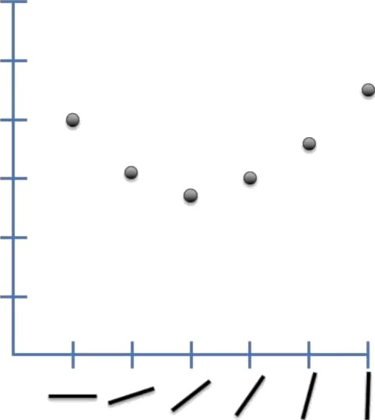
Sum of squared residuals
Different rotations:

Slide 15
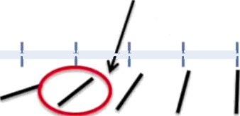
e
Sum of - e
squared
re5iduals --
e
e
e
e
This rotation is one with the “least
Squares”, 5O it will be
the one fit to the data.
Different rotation5:

Slide 16
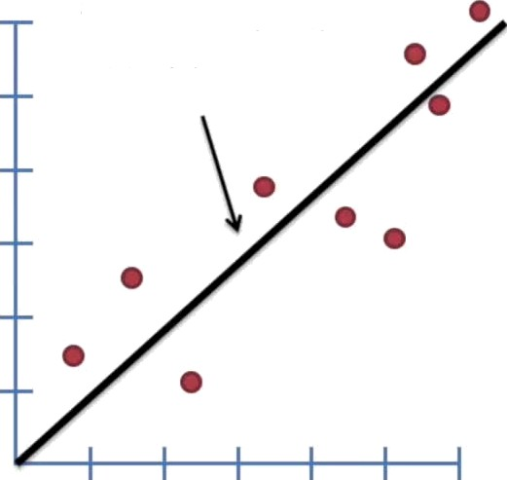
ThI5 i5 our “Iea5t squares” rotation 5uperimpo5ed on the original data.
Mouse size
Mouse weight

Slide 17
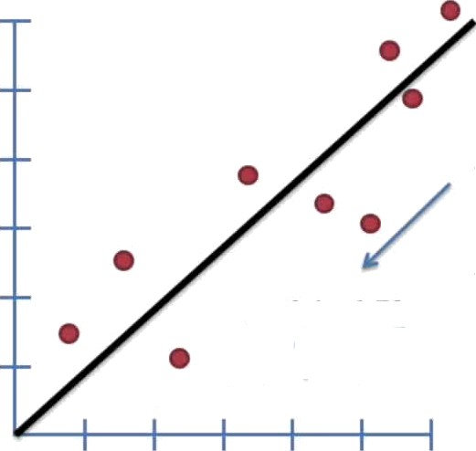
Now we have fit a line to the data! Thi5 i5 awesome!
Here's the equation for the line.
Mouse size
Least-squares estimated two parameters:
y —— 0.1 + 0.78x
A y-axis intercept...
...and a slope
Mou5e weight

Slide 18
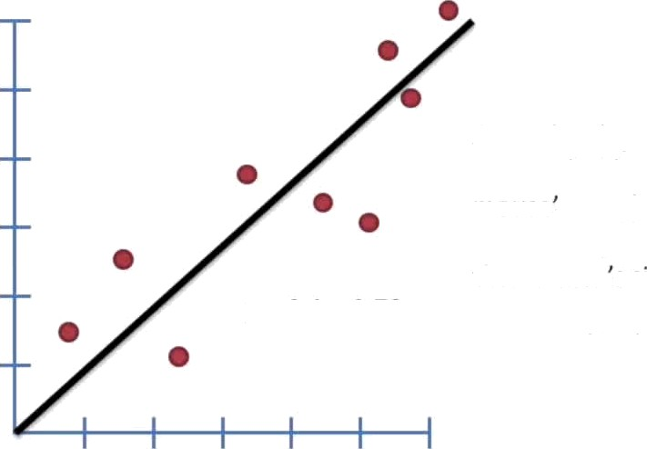
Now we have fit a line to the data! Thi5 is awesome!
Since the slope is not 0, it means that knowing a mouse 5 weight will help us make a guess about that mouse 5 size.
Mouse size
y ——0.1 + 0.78x
How good is that guess?
Mou5e weight

Slide 19
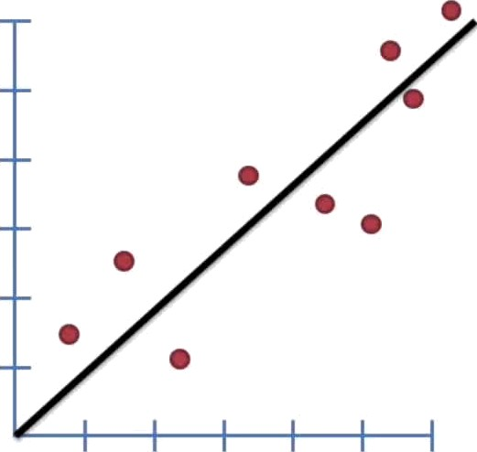
Calculating R* is the first step in determining how good that guess will be.
Mouse size
Mou5e weight

Slide 20
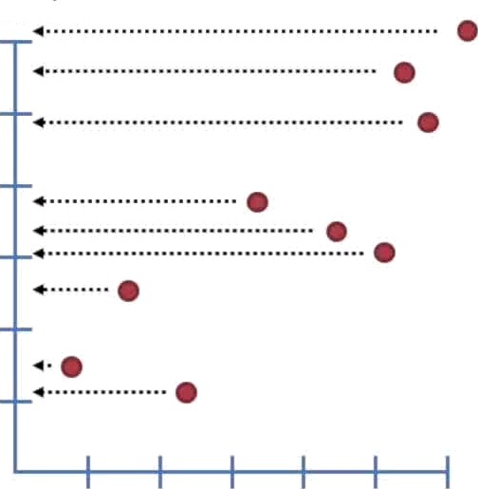
Mouse size
First, calculate the
average mouse size.
Mouse weight

Slide 21
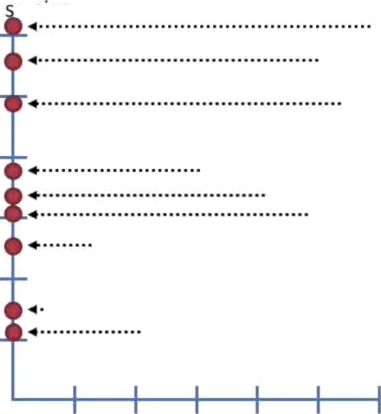
Mou e size
First, calculate the
average mouse size.
Mouse weight

Slide 22
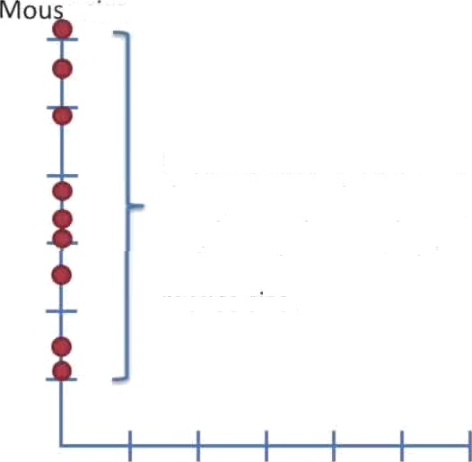
e size
First, calculate the average mouse size.
Here we have shifted all of the data points to the y-axis to emphasize that, at this point, we are only interested in mouse size.
Mou5e weight

Slide 23
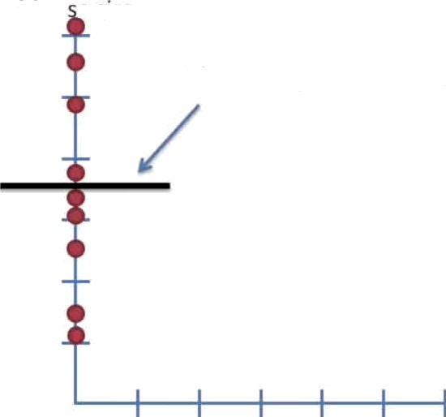
Mou e size
The average mouse size.
First, calculate the average mouse size.
Mouse weight

Slide 24
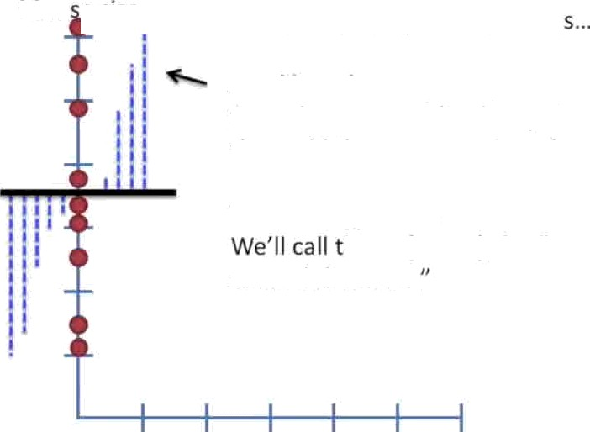
Mou e size
Now sum the Squared residual
Just like in least squares, we measure the distance from the mean to the data point and square it, then add those squares together.
Terminology Alert!
his SS(mean), for “sum of square5 around the mean
Mouse weight

Slide 25
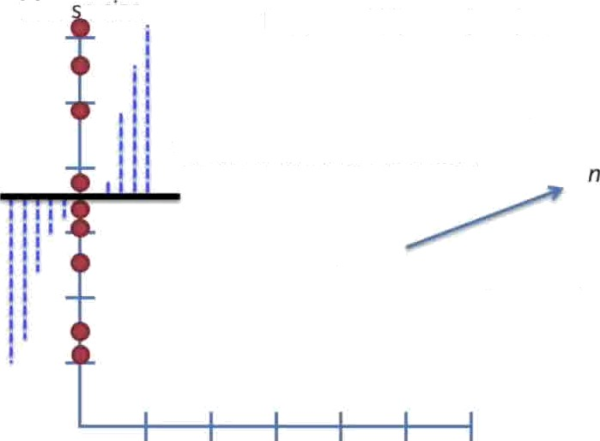
Mou e size
Note:
SS(mean) =
(data - mean)*
(data - mean)*
Variation around the mean =
’n’ is the sample size (in this case, n= 9)
Mouse weight

Slide 26
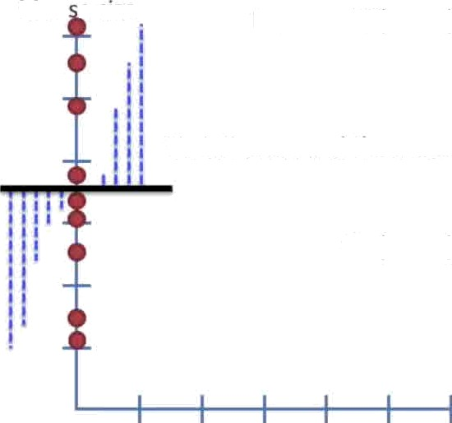
Mou e size
Note:
SS(mean) =
(data - mean)*
(data - mean)*
Variation around the mean =
SS(mean)
Var(mean) =
n
Mouse weight

Slide 27
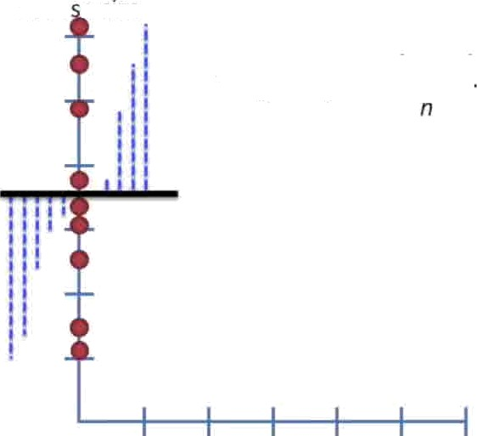
Mou e size
Another way to think about variance is as the average sum of squares per mouse.
SS(mean)
Var(mean) =
Mou5e weight

Slide 28
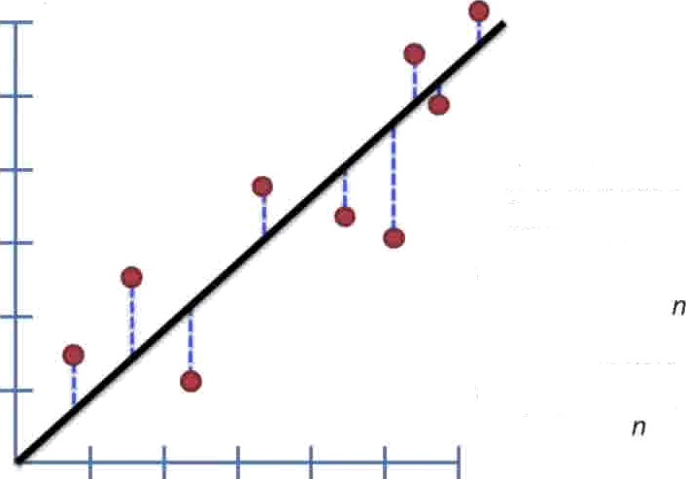
Now go back to the original plot.
Sum up the squared residuals around our least-squares fit.
We'll call this SS(fit), for the sum of squares around the least-squares fit.
SS(fit) = (data - Iine)²
Just like with the mean, the variance around the fit...
(data - line)’
Var(fit) =
SS(fit)
Var(fit) =
Mou5e weight

Slide 29
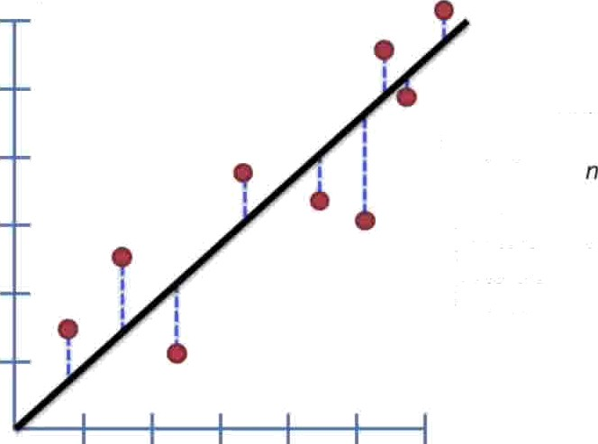
Now go back to the original plot.
Sum up the squared residuals around our least-squares fit.
We'll call this SS(fit), for the sum of squares around the least-squares fit.
SS(fit) = (data - line)*
S5(fit)
Var(fit) =
Again, we can think of Var(fit) as the average SS(fit) for each mouse.
Mou5e weight

Slide 30
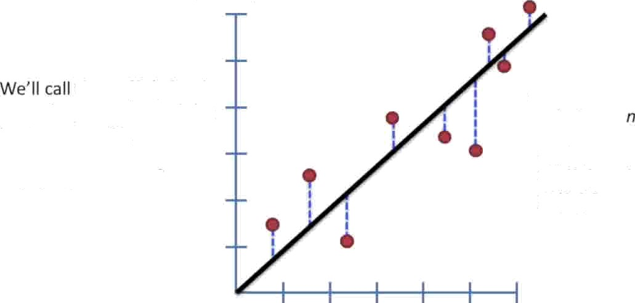
Now go back to the original plot.
Sum up the squared residuals around our least-squares fit.
this SS(fit), for the sum of squares around the least-squares fit.
ss(fit)
Var(fit) =
Again, we can think of Var(fit) as the average SS(fit) for each mouse.
SS{fit) = (data - line)*
Sums of squares
In general: Variance(5omething) =
= Average sum of squares.
The number of those things

Slide 31
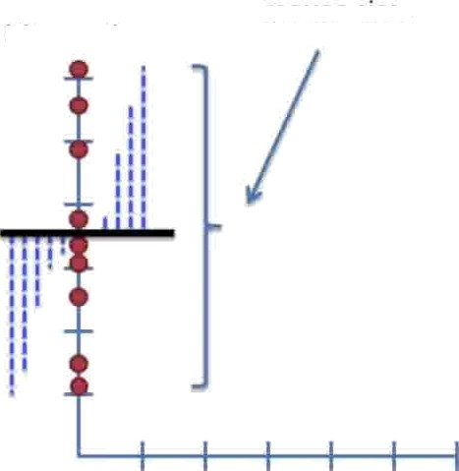
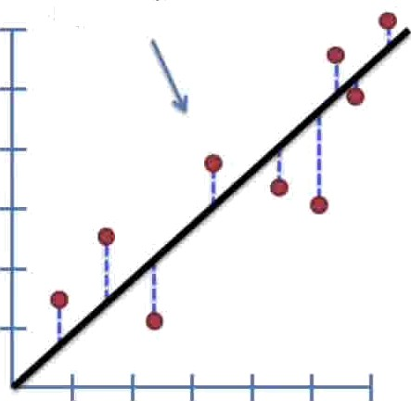
This is the raw variation in mouse size.
This is the variation around the least squares line.
Mouse size
Mouse weight

Slide 32
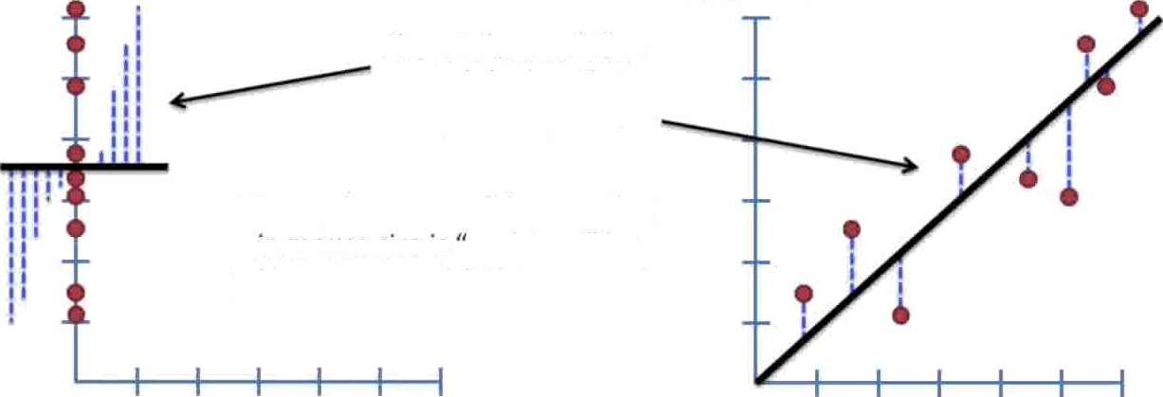
Mouse Size
Mouse size
There is less variation around the line that we fit by least-squares.
We say that some of the variation in mouse size is explained" by taking mouse weight into account.
Heavier mice are bigger. Lighter mice are smaller.
Mouse weight

Slide 33
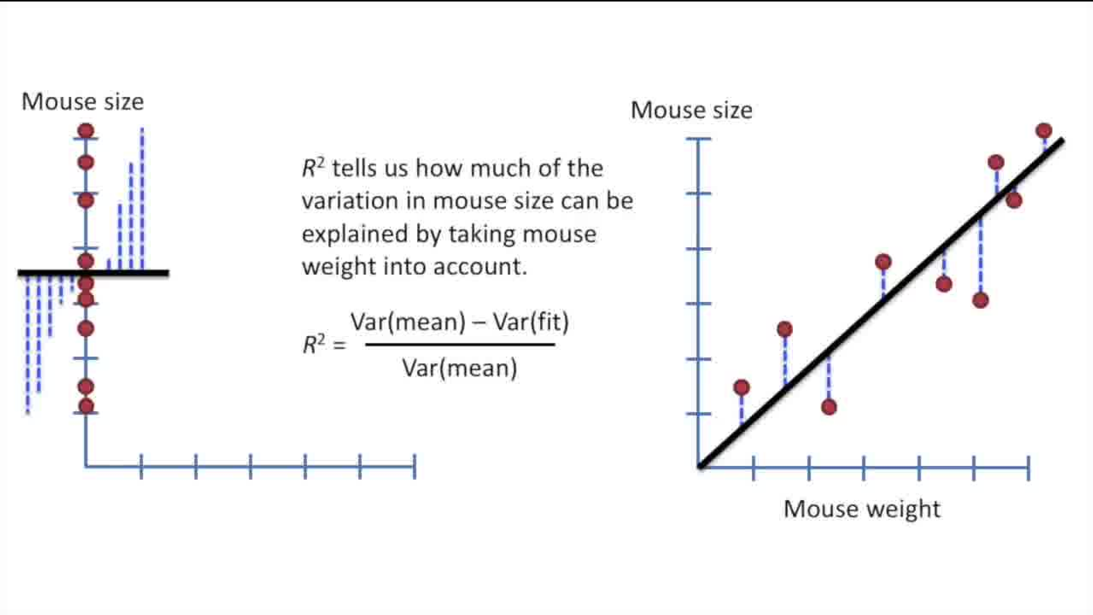

Slide 34
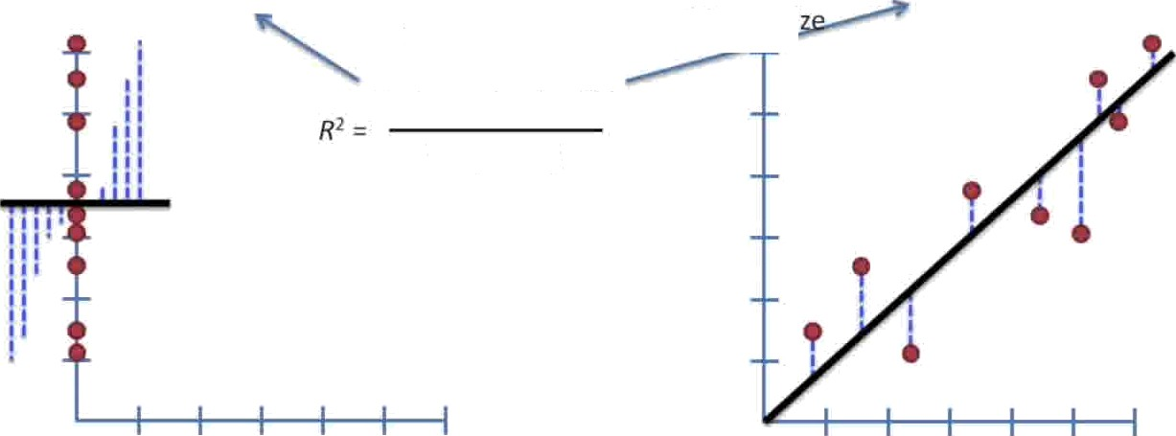

Var(fit) = 4.4
Var(FFiRãFï) -
. Ż
Mouse si
For example...
Var(mean) — Var(fit) Var(mean)
Mouse weight

Slide 35
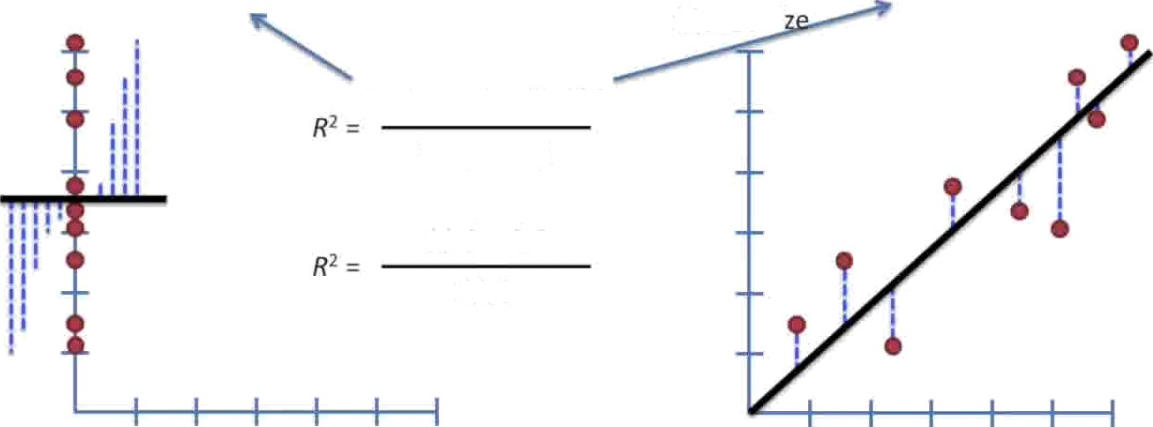
Var(fit) = 4.4
Var(mean) = 11.1
Mouse si
Var(mean) — Var(fit) Var(mean)
11.1-4.4
11.1
Mouse weight

Slide 36

Var(mean) = 11.1
Var(fit) = 4.4
Mouse si
Var(mean) — Var(fit) Var(mean)
11.1-4.4
R' -- 0.6
Mouse weight

Slide 37

Var(fit) = 4.4
Var(mean) = 11.1
Mouse si
Var(mean) — Var(fit) Var(mean)
11.1 -4.4
11.1
R² = 0.6 = 60%
Mouse weight

Slide 38
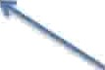
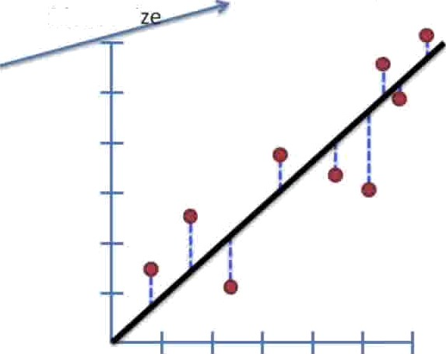


Var(mean) = 11.1
Var(fit) = 4.4
Mouse si
Var(mean) — Var(fit)
‹
l! ‹
q* =
Var(mean)
‹›
11.1 — 4.4
R! ——
11.1
"
R* = 0.6 = 60%
There is a 60% reduction in variance when we take the mouse weight into account.
Mouse weight

Slide 39
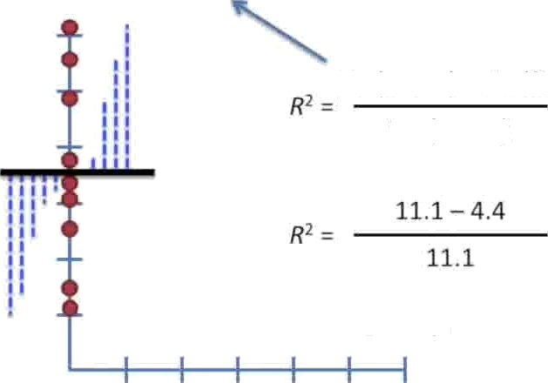

Var(mean) = 11.1
Var(fit) = 4.4
Mouse si
Var(mean) — Var(fit)
Var(mean)
R! ——0.6 = 60%
There is a 60% reduction in variance when we take the mouse weight into account.
Alternatively, we can say that mouse weight “explains” 60% of the variation in mouse size.
Mouse weight

Slide 40
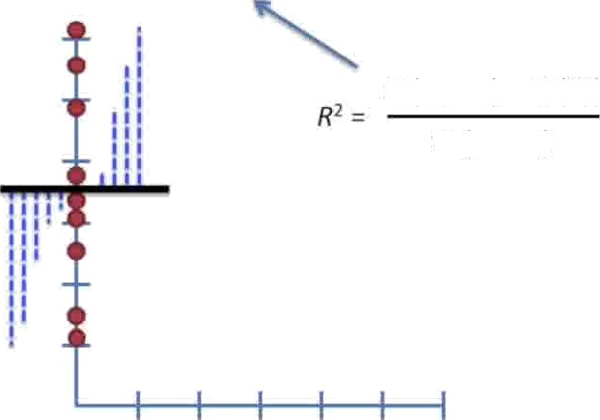

We can also use the sums of squares to make the same calculation.
SS(mean) = 100
SS(fit) = 40
SS(mean) — SS(fit) SS(mean)

Slide 41

We can also use the sums of squares to make the same calculation.
SS(mean) = 100
SS(fit) = 40
SS(mean) — SS(fit) SS(mean)
100 — 40
10o

Slide 42

We can also use the sums of squares to make the same calculation.
SS(mean) = 100
SS(fit) = 40
SS(mean) — SS(fit) SS(mean)
100 — 40
10o
V'06=60%

Slide 43

We can also use the sums of squares to make the same calculation.
SS(mean) = 100
SS(fit) = 40
SS(mean) — SS(fit) SS(mean)
100 — 40
100
R²=0’6=60%
60% of the sums of squares of the mouse size can be explained by mouse weight..

Slide 44
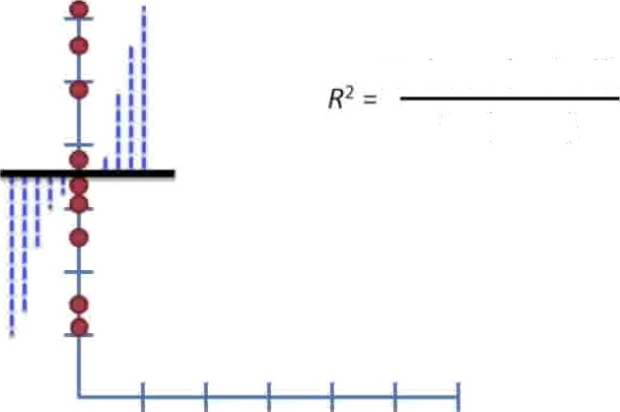
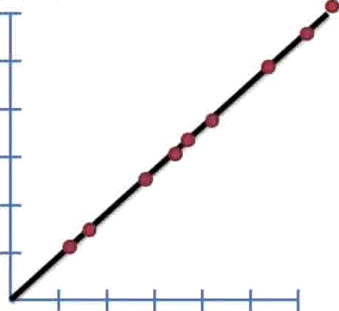
Another Example...
Mouse size
Var(mean) — Var(fit) Var(mean)
Mouse weight

Slide 45
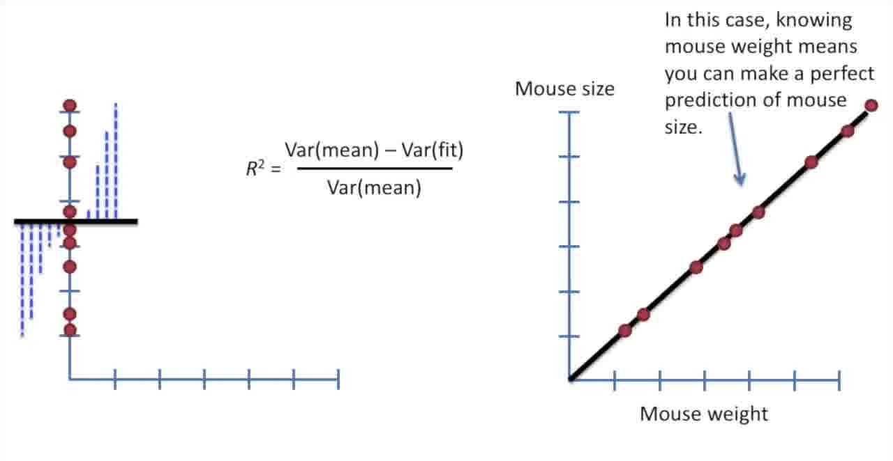

Slide 46
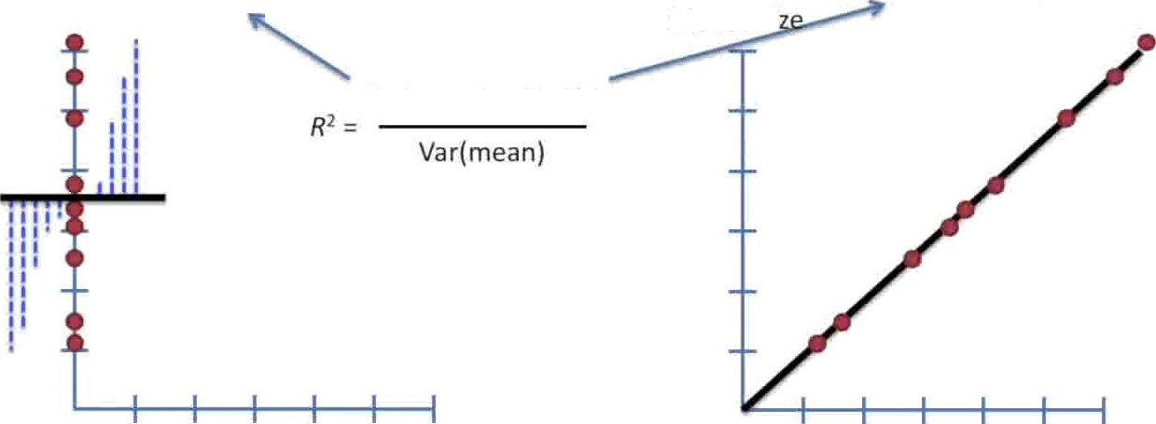
Var(mean) = 11.1
Var(fit) = 0
Mouse si
Var(mean) — Var(fit)
Mouse weight

Slide 47
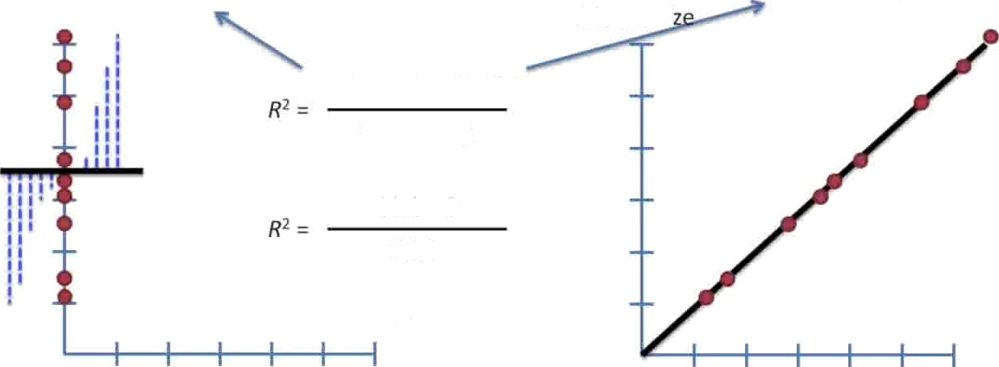
Mouse si
Var(mean) = 11.1
Var(fit) = 0
Var(meari) — Var(Ńt) Var(mean)
11.1 - 0
11.1
R² = 1 = 100%
Mouse weight

Slide 48
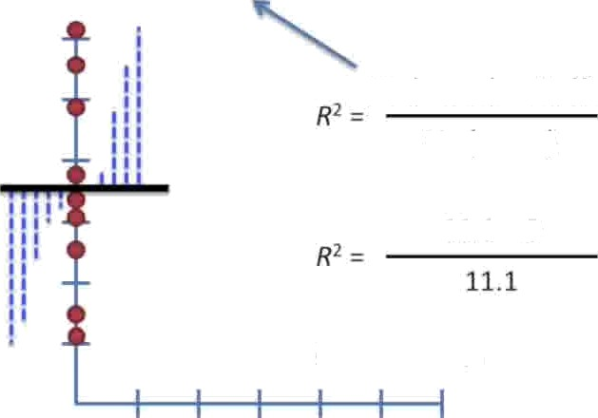
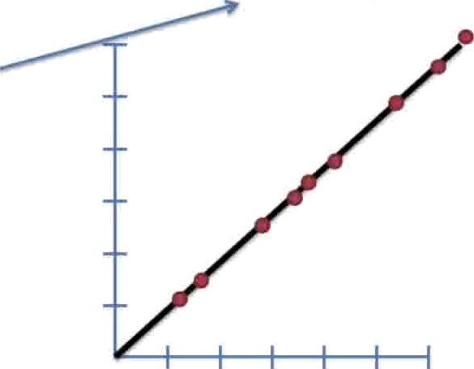
Var(fit) = 0
Var(mean) = 11.1
Var(mean) — Var(fit) Var(mean)
11.1 — 0
P* = 1 = 100%
In this case, mouse weight “explains“ 100% of the variation in mouse size.

Slide 49
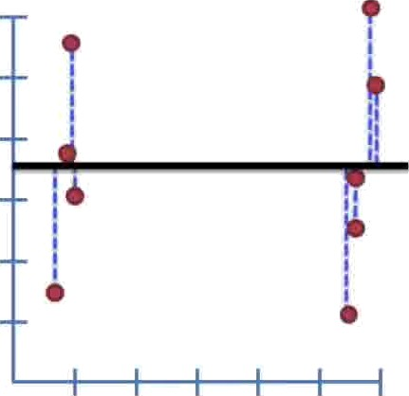

One last example..,
Var(mean) = 11.1
Var(mean) — Var(fit) Var(mean)
R* ——
Mouse weight

Slide 50
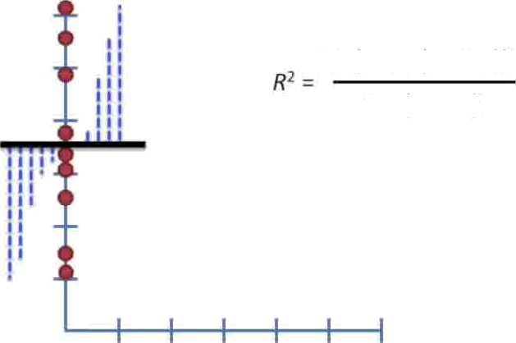
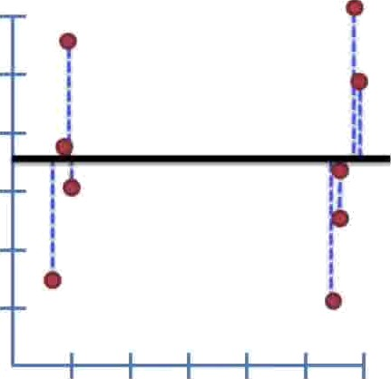
In this case, knowing mouse weight doesn't help us predict mouse size.
Var(mean)
11.1
Var(mean) — Var(fit) Var(mean)
Mouse weight

Slide 51


In this ca5e, knowing mouse weight doesn't help us predict mouse size.
Var(mean) = 11.1
Var(mean) — Var(fit) Var(mean)
Mouse weight

Slide 52


In this case, knowing mouse weight doesn't help us predict
e size.
Var(mean) = 11.1
Var(mean) — Var(fit) Var(mean)
Mouse weight

Slide 53


Var(mean) = 11.1
Var(fit) = 11.1
Var(mean) — Var(fit) Var(mean)

Slide 54


Var(mean) = 11.1
Var(fit) = 11.1
t Var(mean) — Var(Èt)
Var(mean)
11.1 - 11.1
11.1
R! --
R² = 0 = 0Ø

Slide 55

Var(mean) = 11.1
Var(fit) = 11.1
Var(mean) — Var(fit)
11.1 — 11.1
R'=0=0%
In this case, mouse weight doesn't “explain“ any of the variation around the mean.

Slide 56

SS(mean)
When calculating SS{mean), we collapsed the points onto the y-axis just to emphasize the fact that we were ignoring mouse weight.

Slide 57

SS(mean)
Mouse size
But we could just draw a line,
y ——mean mouse size
Mouse weight

Slide 58

SS(mean)
Mouse size
But we could just draw a line,
y = mean mouse size
and calculate SS(mean) around that.
Mouse weight

Slide 59

In this example, we applied R* to a simple equation for a line.
y = 0.1 + 0.78x
Mouse size
Mouse weight

Slide 60

In this example, we applied R' to a simple equation for a line.
y = 0.1 + 0.78x
R* = 60%
Mouse size
Mouse weight

Slide 61




















Simple Linear Regression
Managerial decisions often are based on the relationship between two or more variables.
Regression analysis can be used to develop an equation showing how the variables are related.
The variable being predicted is called the dependent variable and is denoted by y.
The variables being used to predict the value of the dependent variable are called the independent variables and are denoted by x.

Slide 62













Simple Linear Regression
Simple linear regression involves one independent variable and one dependent variable.
The relationship between the two variables is approximated by a straight line.
Regression analysis involving two or more independent variables is called multiple regression.

Slide 63































Simple Linear Regression Equation
The simple linear regression equation is:
E(y) = ₀ + ₁x
•
•
•
•

Slide 64
















Simple Linear Regression Equation
Positive Linear Relationship
E(y)
Regression line
Intercept
β₀
Slope β₁
is positive
x

Slide 65







Simple Linear Regression Equation
Negative Linear Relationship
E(y)
Intercept
β₀
Regression line
Slope β₁
is negative
x

Slide 66







Simple Linear Regression Equation
No Relationship
E(y)
Intercept
β₀
Regression line
Slope β₁
is 0
x

Slide 67














Estimated Simple Linear Regression Equation
■
yˆ = b₀ + b₁ x
•
•
•
yˆ

Slide 68

























































Estimation Process
Regression Model
y = β₀ + β₁x +ε Regression Equation E(y) = β₀ + β₁x Unknown Parameters
β₀, β₁
Sample Data:
x y
x₁ y₁
. .
. .
x_{n} y_{n}
Estimated
b₀ and b₁
provide estimates of
β₀ and β₁
Regression Equation
yˆ = b₀ + b₁x
Sample Statistics
b₀, b₁

Slide 69


















Least Squares Method
Slope for the Estimated Regression Equation
∑
(x − x )(y_{i} − y )
b =
i
∑(x − x)²
1
i

Slide 70







Least Squares Method
y-Intercept for the Estimated Regression Equation
b₀ = y − b₁ x

Slide 71


Simple Linear Regression
Example: Reed Auto Sales
Reed Auto periodically has a special week-long sale. As part of the advertising campaign Reed runs one or more television commercials during the weekend
preceding the sale. Data from a sample of 5 previous sales are shown on the next slide.

Slide 72


























Simple Linear Regression
Example: Reed Auto Sales
Number of | Number of
TV Ads (x) | Cars Sold (y)
1 | 14
3 | 24
2 | 18
1 | 17
3 | 27
Σx = 10 | Σy = 100
x = 2 | y = 20

Slide 73







Estimated Regression Equation
Slope for the Estimated Regression Equation
∑
(x − x)(y_{i} − y ) ₌ 20 ₌ ₅
b =
i
1
∑(x − x)²
4
i
y-Intercept for the Estimated Regression Equation
b₀ = y − b₁ x = 20 − 5(2) = 10
Estimated Regression Equation
yˆ = 10 + 5x

Slide 74
Cacu
late R | 2

Slide 75
Calculate R²
Y^ | Y | Y^ - Y | (Y^ - Y )² | Y – Y’ | (Y - Y’)²
15 | 14 | 1 | 1 | -6 | 36
25 | 24 | 1 | 1 | 4 | 16
20 | 18 | 2 | 4 | -2 | 4
15 | 17 | 2 | 4 | -3 | 9
25 | 27 | 2 | 4 | 7 | 49
SS(mean) = 114
SS(fit). = 14
Y^ = Y predicted Y’ = Y mean
R2 = [SS(mean) – SS(fit)] / SS(mean) R2 = 87%

Slide 76


Example of Linear Relationship
76

Slide 77

Example - SLR
Y = a + bX
_{𝑏 =} ∑(𝑥$𝑥)∗(𝑦$𝑦)
∑(𝑥$𝑥)²
𝑎 = 𝑌 − 𝑏𝑋
𝑏 =611.36 / 94.18 = 6.49
𝑎 =Y - bX
Now Predicting Grade(Y) for student who spent 2.35 hours
Y = 30.18 + 6.49 * X
Y = 45.43
77

